Slide 1
SENSORS DATA: WEB USER BEHAVIOR ANALYSIS(WEB LOGS)
Cindy Huang

Slide 2
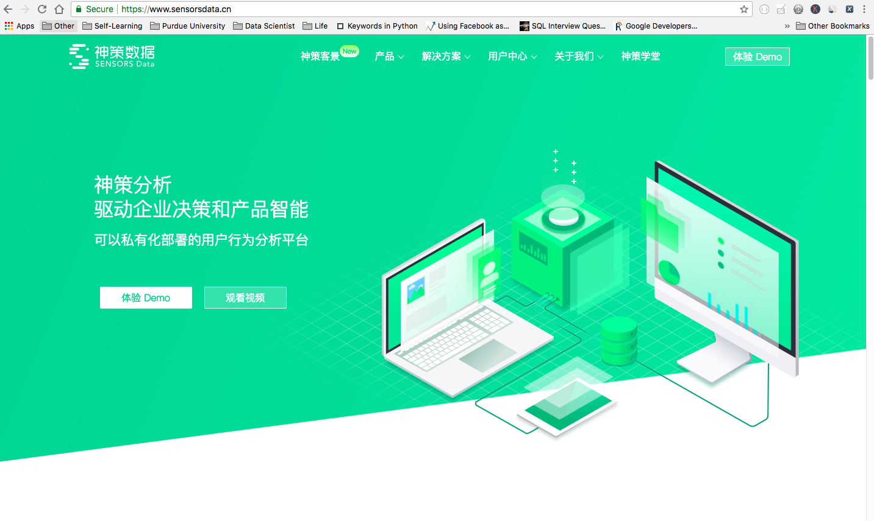

Slide 3
